Slide 1

IRONHACK
An agile approach to job hunting
CAREER SERVICES | REMOTE

Slide 2


INDEX
What is Agile?
Why applying agile to the job hunt?
Before starting
Executing

Slide 3
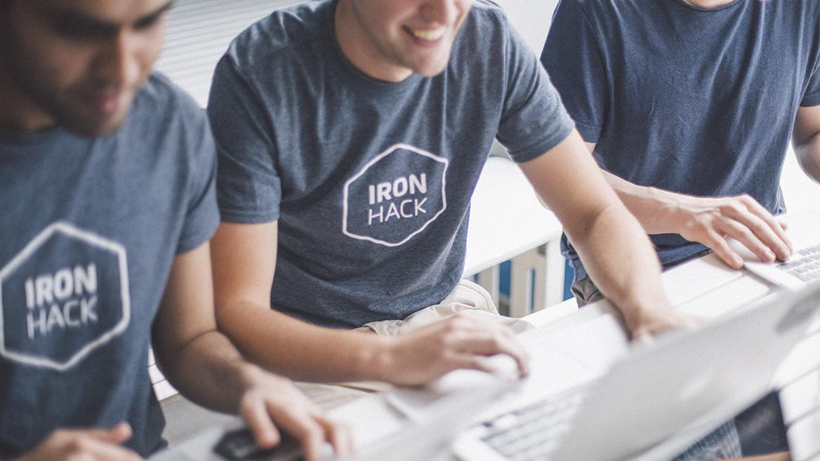
The Agile Methodology proposes flexibility and team-based approach to development, creating more productive ways of working by dividing the project into various phases called “sprints.” Each sprint usually lasts for a few weeks, and team members follow a running list of deliverables. When the sprint ends, all work can be reviewed and evaluated by the team.
Adevait.com

Slide 4


The Agile Values
The ‘Agile Manifesto’ was born in 2001 to revolutionise the future of software development - moving away from excessive planning and documenting (“Waterfall approach”).
With Agile - work is reviewed more often, there’s room for faster and more regular feedback (PM/Scrum Master/ customer) and opportunity to make needed corrections. Collaboration, adaptive planning, continuous delivery, and customer satisfaction are at the center.
There are many agile frameworks that have emerged - all embodying the core principles of frequent iteration, continuous learning, and high quality in its own way.
Notes:
Whats the enterprise model?
Ironhack attracts, qualifies, and trains Emerging Talent while reducing the risks by using a Hire, Train and Deploy model.
Ironhack manages the end-to-end process of creating a candidate pipeline, qualifying top performers, and building your team through intensive tech training.
Once trained, Ironhackers are deployed to your workforce through an accelerated 24-month program. Ironhack provides upskilling, mentorship, and community to reduce onboarding time, hand-holding from your team, and reduce attrition.
We employ Alumni, so you can focus on business as usual.
Once the assignment ends, Ironhackers become valuable team members. Convert to hire at no extra cost.
Since we continue to see those issues in all our hiring partners, we built a dedicated program that addresses them directly.."

Slide 5
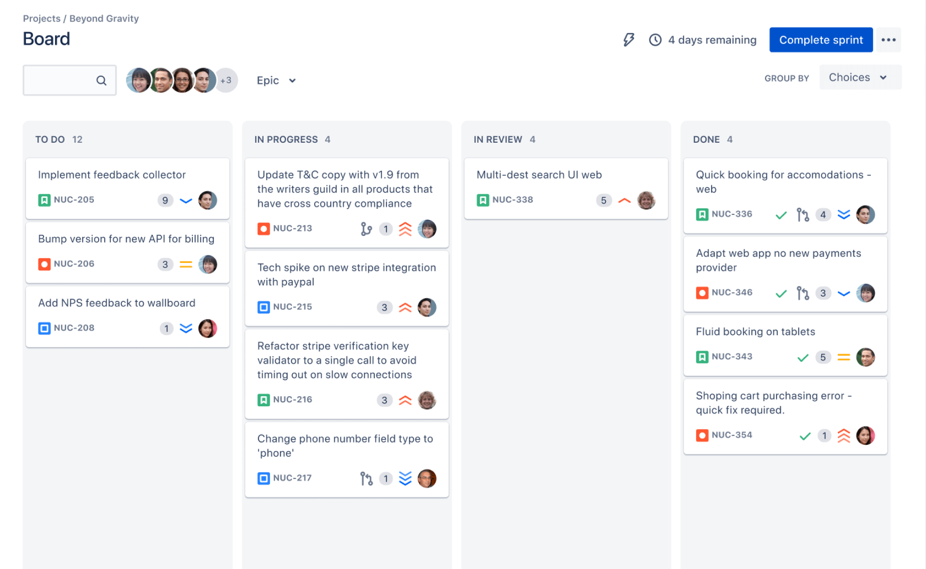
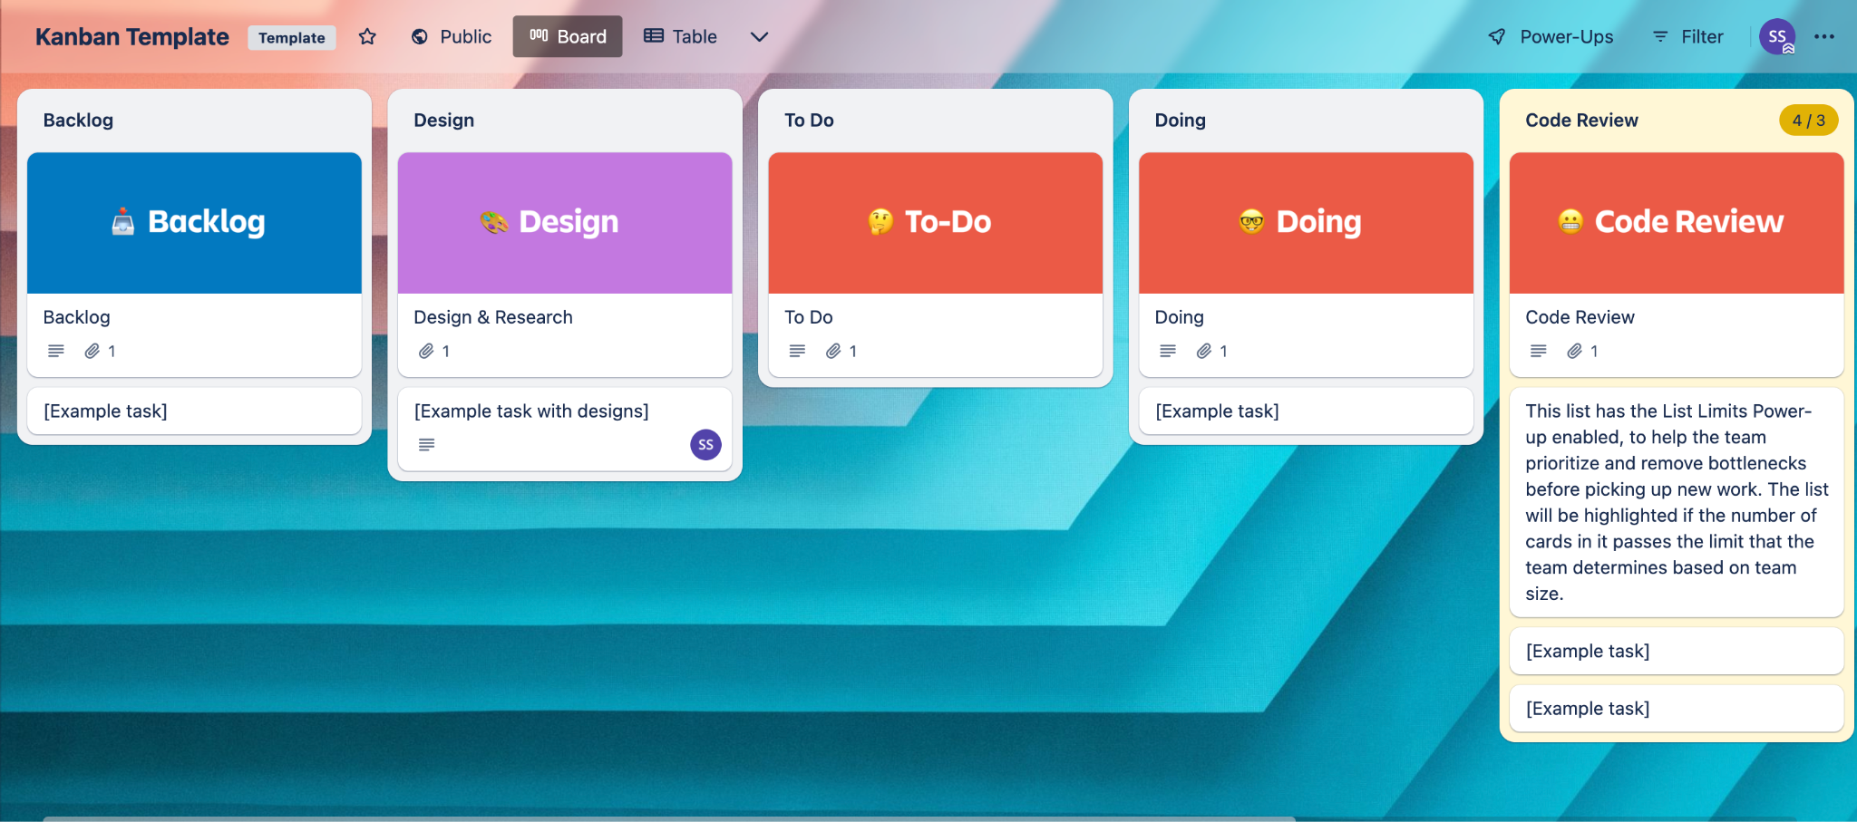
For example, SCRUM is favored by dev teams, while Kanban is big among service-oriented teams like IT or HR.
eworks: i.e. Scrum, Kanban, etc.
Trello board
Jira board

Slide 6
“Agile is the ability to create and respond to change. It is a way of dealing with, and ultimately succeeding in, an uncertain and turbulent environment.”
AgileAlliance.org

Slide 7
Want to learn more about Agile?
👩🏽‍💻 AgileManifesto.org
👩🏽‍💻 Scrum.org
👩🏽‍💻 AgileAlliance.org
📖 Scrum: The Art of Doing Twice the Work in Half the Time
🤓 Google, Coursera, Udemy
👩🏽‍💻 Kanban vs Scrum

Slide 8
WHY AGILE JOB HUNTING?

Slide 9
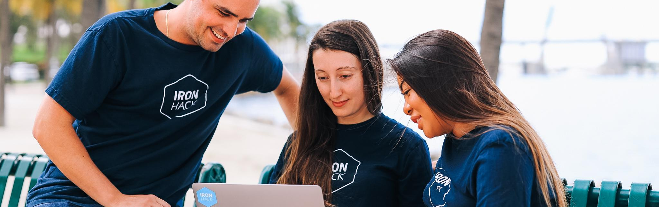

Project management
Goal setting
Adaptive planning
Hands on practice
Sustainable workflow
Job hunting is a complex process consisting of various elements and stages
Setting short-term, achievable milestones towards a defined goal: Find (good) employment
Constantly collecting feedback, iterating throughout the process to maximise effectiveness.
Anticipating market needs before joining a tech team, learning and applying agile values and principles.
Goal setting and a structured framework fosters productivity, motivation and mental health.

Slide 10
Overall steps of the process
DAILY SCRUM
MONTHLY SPRINT RETROSPECTIVE
SET YOUR GOAL
BACKLOG
How did it go yesterday? What’s on for today? What should be the focus? Do I need external help?
What worked/didn’t? What can I do better? Am I using the right approach?
Use the SMART Method to clearly define
Create a list of all the tasks and areas you need to work on
Phase
Phase
Phase
Phase
Phase
Phase
Phase
01
02
03
04
05
06
07
DEFINE ROADMAP
SPRINT PLANNING
SPRINT REVIEW
How do you imagine the road towards your goal? What needs to happen?
Work on 1 week sprints. Set easy-to-assess milestones; make necessary changes swiftly.
Be realistic and flexible.
What did I achieve? Did I meet my goals? (i.e. talk to X recruiters, finish my CV, send 5 applications, etc.)

Slide 11
SETTING YOUR GOAL

Slide 12

The SMART Goal
SPECIFIC
Narrow it down to the specifics to better understand what steps it'll take you to achieve it.
MEASUREABLE
Make sure there's a metric you can rely on to track progress.
ACHIEVABLE
Do you have the fundamentals of what's needed to achieve it? Is it realistic or feasible?
RELEVANT
Does it align with your larger purpose in life? Make sure you feel motivated
Your destination needs to have an exact address
TIMED
Set a deadline to stay motivated and help yourself prioritise
*Optional deliverable on SMART Goal

Slide 13

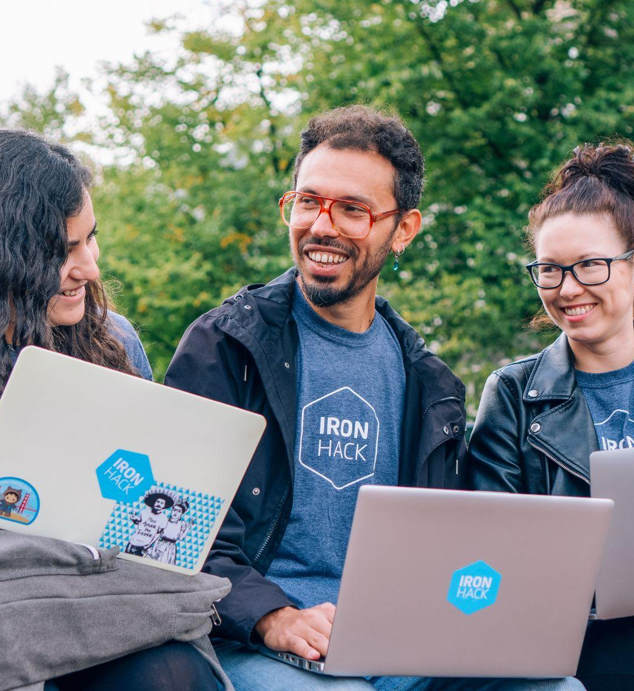
Define your end goal
“I will sign a job contract as a junior frontend developer within 6 months after graduating from Ironhack”
Define a SMART goal for your weekly sprint
“I will update my CV/LinkedIn with all my relevant skills and apply to 5 junior UX/UI designer positions by Friday.”
Be flexible
If need be, reassess your goal to adjust it to your current circumstances.
Notes:
Whats the enterprise model?
Ironhack attracts, qualifies, and trains Emerging Talent while reducing the risks by using a Hire, Train and Deploy model.
Ironhack manages the end-to-end process of creating a candidate pipeline, qualifying top performers, and building your team through intensive tech training.
Once trained, Ironhackers are deployed to your workforce through an accelerated 24-month program. Ironhack provides upskilling, mentorship, and community to reduce onboarding time, hand-holding from your team, and reduce attrition.
We employ Alumni, so you can focus on business as usual.
Once the assignment ends, Ironhackers become valuable team members. Convert to hire at no extra cost.
Since we continue to see those issues in all our hiring partners, we built a dedicated program that addresses them directly.."

Slide 14
DEFINING YOUR ROADMAP

Slide 15

Visualize the path towards your goal
What will it take for me to get there? Where do I need to be right before I reach my goal? How does it look like? What will I have accomplished by then?
Where am I right now in the journey? Where can I start? What should be my priority at the moment?
What have others done to get there?

Slide 16
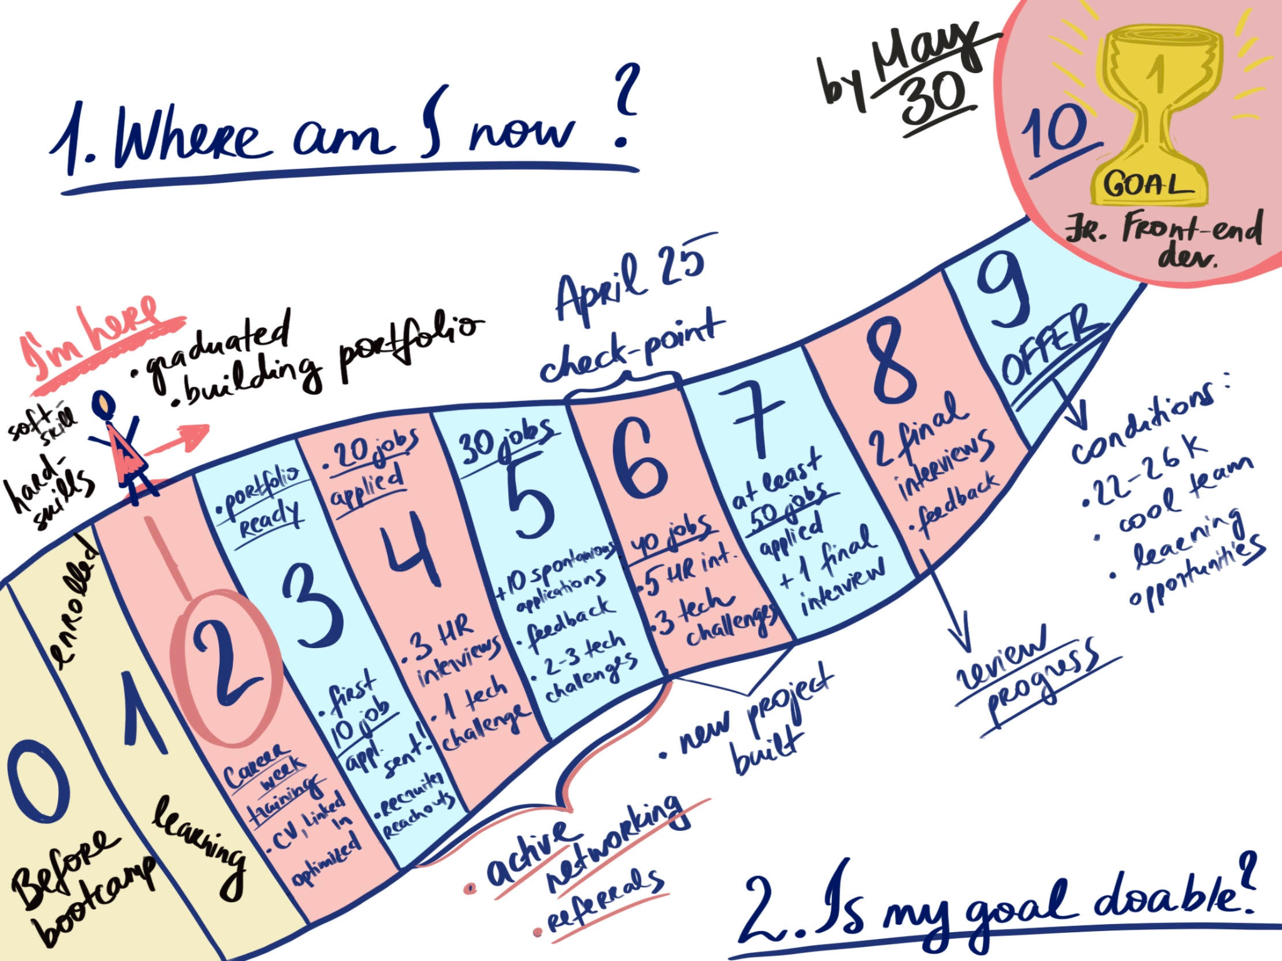
*Optional deliverable on Defining your Roadmap

Slide 17
The steps of the process
DAILY SCRUM
MONTHLY SPRINT RETRO
SET YOUR GOAL
BACKLOG
How did it go yesterday? What’s on for today? What should be the focus? Do I need external help?
What worked? What didn’t? What can I do better? Am I using the right approach? What new perspective can I bring on?
Use the SMART Method to clearly define
Create a list of all the tasks and areas you need to work on
Phase
Phase
Phase
Phase
Phase
Phase
Phase
01
02
03
04
05
06
07
DEFINE ROADMAP
SPRINT PLANNING
SPRINT REVIEW
How do you imagine the road towards your goal? What needs to happen?
Work on 1 week sprints. Set easy-to-assess milestones; make necessary changes swiftly.
Be realistic and flexible.
What did I achieve? Did I meet my goals? (i.e. talk to X recruiters, finish my CV, send 5 applications, etc.)

Slide 18
MULTITASKING IN THE JOB HUNT

Slide 19

TECH SKILLS
Review bootcamp material and continue practicing
PORTFOLIO & PROJECTS
Apply your acquired skills in projects you can showcase to employers
CONTINUOUS LEARNING
Continue expanding your technical skills through courses & certifications
JOB HUNTING
Your routine checking job boards and prospecting potential companies
NETWORKING
Connecting to professionals online and onsite, including in-person events
Your destination needs to have an exact address
SOCIAL & FITNESS
Taking care of family, friends and personal & physical wellbeing

Slide 20
AGILE TOOLS FOR JOB HUNTING

Slide 21
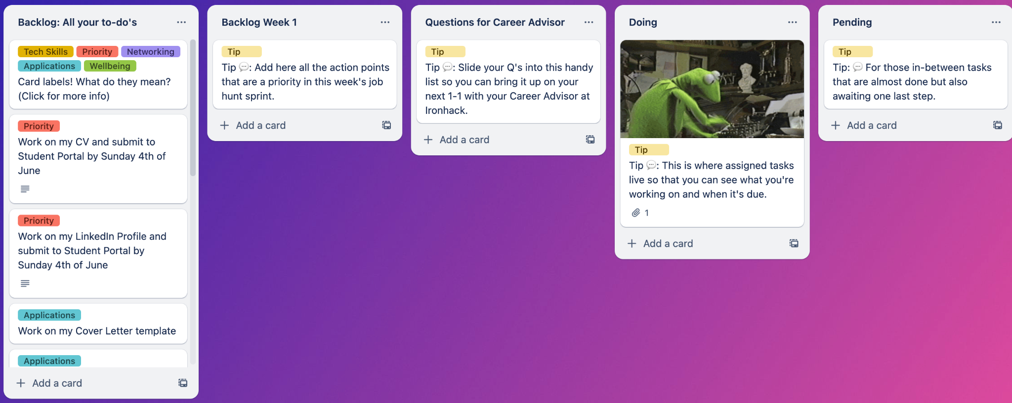
Click to access the Trello board

Slide 22
BEFORE YOU START: PRIORITISE

Slide 23
What do you need to care care of right now?
Create a list of 6-8 things/areas that you need to pay attention to right now
Assign them a value from 0-10
Draw a circle and represent your areas in it
Now you have a good idea of what you can start working on

Slide 24
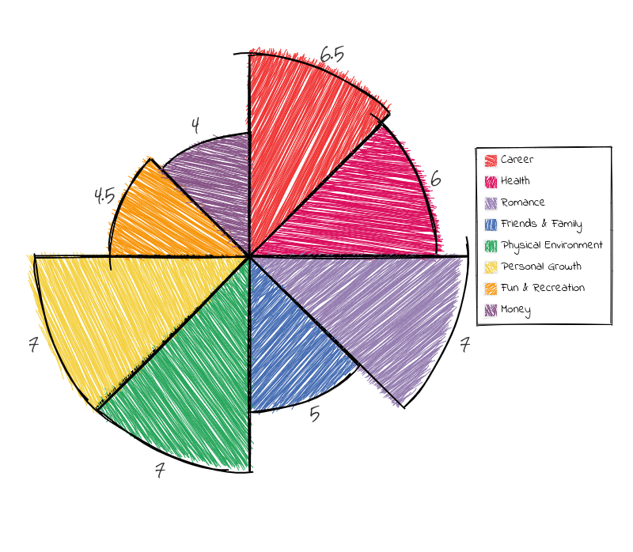
CV & LinkedIn 4/10
Modules 1 & 2 6/10
Portfolio 7/10
Job applications 5/10
Family time 7/10
Exercise 7/10
1-1 Careers 4.5/10
10
9
Github M. 1&2 1 review Portfolio
Applying jobs
Exercising
Family
1-1 Career Adv.
CV & LinkedIn
8

Slide 25
Thanks!
IRONHACK 2023. ALL RIGHTS RESERVED.

